Slide 1
Lecture 2: History of Software Engineering
Mia Mohammad Imran

Slide 2
Today’s Agenda
Evolution of Software Engineering
Creating a “Program”

Slide 3
def x(a, b=None, c=True):
if not c: return []
d = b or lambda y: y % 2 == 0
e = [i for i in a if d(i)]
f = {}
for g in e:
h = str(g)[::-1]
if h in f:
f[h] += 1
else:
f[h] = 1
return sorted(f.items(), key=lambda k: (-k[1], k[0]))
z = lambda a,b=lambda x:x%2<1,c=1: sorted({str(i)[::-1]:a.count(int(str(i)[::-1])) for i in a if b(i) and c}.items(),key=lambda x:(-x[1],x[0])) if c else []

Slide 4
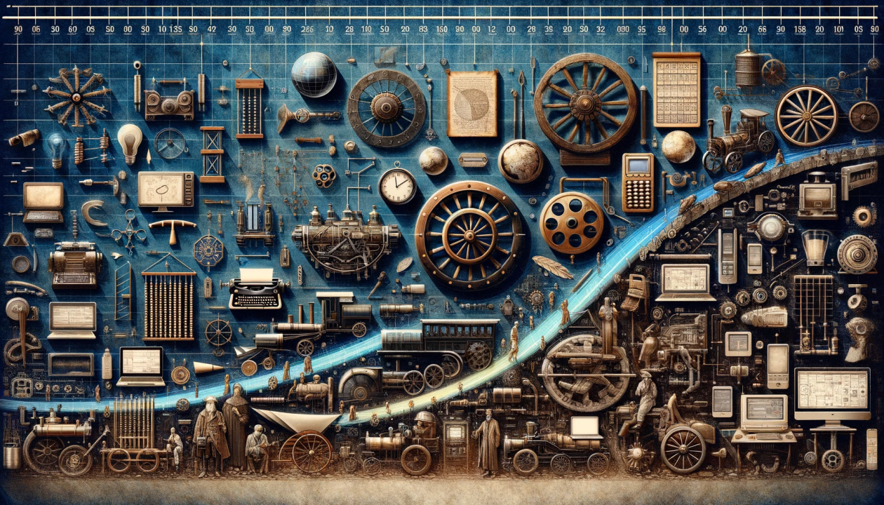
Evolution of Software Engineering

Slide 5
Evolution of Software Engineering
Software Engineering as a response to challenges in complex systems
Evolution from programming methods to methodologies addressing cost, quality, and reliability

Slide 6
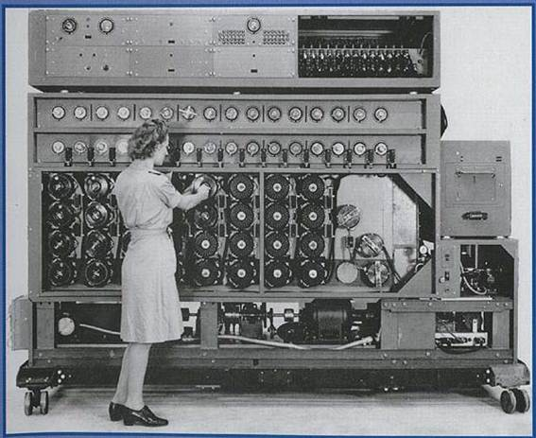
Early Years (1940s-1950s)
Programming began with direct machine code
Programs were written for specific hardware with no abstraction layers
Software development was considered more of an art than an engineering discipline

Slide 7
The Advent of Programming (1950s-1960s)
Focus on hardware, software secondary
Notable development: Creation of the first compiler in 1952
Early languages: Assembly, FORTRAN, COBOL

Slide 8
You Go From…
Machine Code: 01001000 01100101 01101100 01101100 01101111
To
COBOL: DISPLAY "Hello"

Slide 9
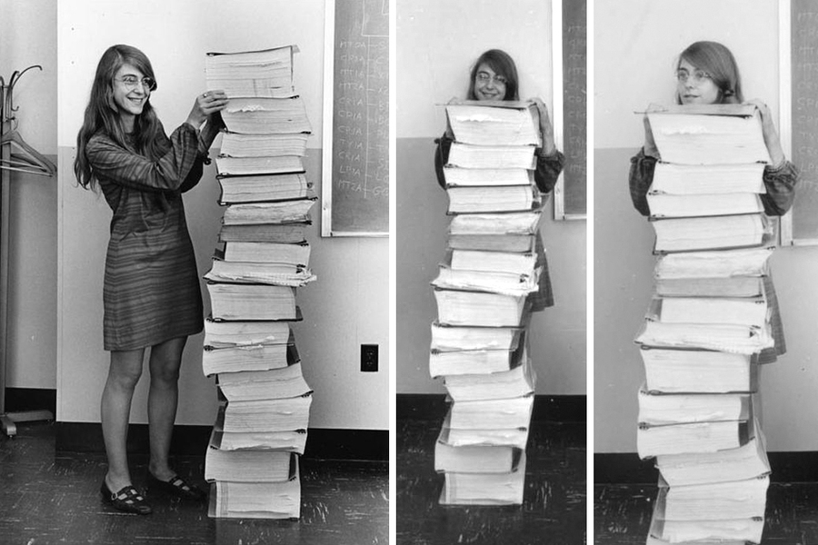
Probably You are Familiar with this Photo…

Slide 10
The “Software Crisis” (late 1960s-1970s)
Coined by NATO at a Software Engineering Conference (1968)
What Lead The Software Crisis
Lack of proper development methodologies
Poor project management
Insufficient testing practices
Inadequate documentation
Over budget
Not meeting all the user’s requirements
Developments:
Structured programming
Birth of software engineering as a discipline

Slide 11
Structured Era (1970s)
Software Engineering is a Discipline…
Fault-free
Delivered on time
Delivered within budget
Satisfies the client’s needs
Introduction of structured programming concepts
Establishment of software development life cycle (SDLC)
Development of the Waterfall Model
International Conference on Software Engineering (ICSE) - 1975

Slide 12
Object-Oriented Programming (1980s-90s)
Concept: OOP emphasized organizing software around "objects" (data structures) rather than just functions or procedures
Modular, reusable code
Introduction of design patterns and reusable components
Development of CASE (Computer-Aided Software Engineering) tools

Slide 13
Agile Transformation (2000s)
Publication of the Agile Manifesto (2001)
Focus on iterative development and customer collaboration
Popular frameworks:
Scrum
Kanban
Extreme Programming (XP)
Emphasis on:
Continuous integration
Test-driven development
Pair programming

Slide 14
DevOps and Cloud Era (2010s)
Emergence of DevOps culture and practices
Cloud computing
Microservices architecture
Key practices:
Continuous deployment
Infrastructure as code
Automated testing and deployment
Containerization (Docker, Kubernetes)

Slide 15
Modern Software Engineering (2020s)
AI-driven development and low-code platforms
GitHub Copilot, Amazon CodeWhisperer, TabbyML, Tabnine, Cursor
Emphasis on security (DevSecOps)
Sustainable and green software engineering
Emerging areas:
Edge computing
Quantum computing
Blockchain technology

Slide 16
Discussion Questions
If a new coding method becomes available which is 10% faster than the current method, then should we adopt it immediately?
Your team inherits a 15-year-old banking system written in COBOL. How would you approach modernizing it while ensuring business continuity?

Slide 17
Creating a “Program”

Slide 18
Considerations and Decisions
We all “start” by learning how to code in some programming language.
With a small, hypothetical, and fairly well defined problem
Usually the code is within one module
We then learn that the program usually does not work on the first try, second try — may be even fifth or sixth try!
We learn about “testing” the program
We learn about re-reading and re-thinking the (problem) requirements more carefully — then find that we may not have all the answers
We learn about tracing and “debugging” the program
Then —- somehow magically —- we decide that it’s “good enough !”

Slide 19
Introduction to creating a program
Problem Statement
“Given a collection of lines of text (strings) stored in a file, sort them in alphabetical order, and write them to another file.”
What are the Program Requirements?

Slide 20
Introduction to creating a program
Problem Statement
“Given a collection of lines of text (strings) stored in a file, sort them in alphabetical order, and write them to another file.”
What are the Program Requirements?
Input formats?
Sorting?
Special cases, boundaries, and error conditions?
Performance?
Real-time?
Security?

Slide 21
Introduction to creating a program
Problem Statement
“Given a collection of lines of text (strings) stored in a file, sort them in alphabetical order, and write them to another file.”
What are the Program Requirements?
Input formats? Sorting? Special cases, boundaries, and error conditions? Performance? Real-time? Security?
What are the Design Constraints?

Slide 22
Introduction to creating a program
Problem Statement
“Given a collection of lines of text (strings) stored in a file, sort them in alphabetical order, and write them to another file.”
What are the Program Requirements?
Input formats? Sorting? Special cases, boundaries, and error conditions? Performance? Real-time? Security?
What are the Design Constraints?
User Interface?
Typical and maximum input sizes?
Platforms?

Slide 23
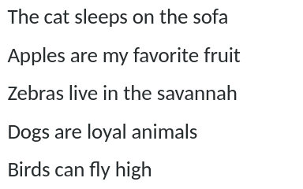
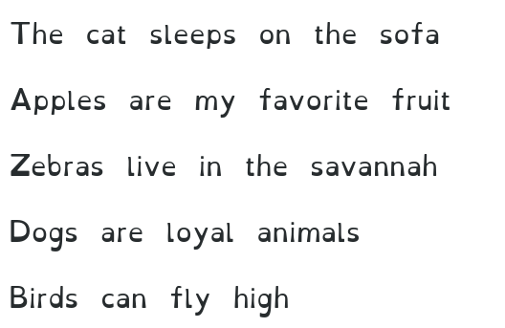
Introduction to creating a program

Slide 24
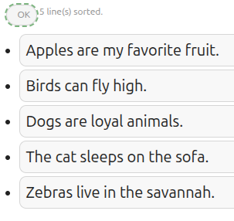
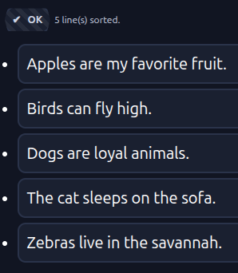
Introduction to creating a program

Slide 25
More to consider and decide on
Testing time
While program is defined
While program is developed
After program is completed
Kinds of tests
Acceptance (validation)
Verification
Unit testing
Black-Box
White-Box

Slide 26
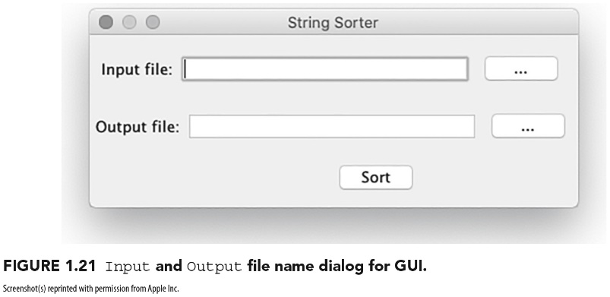
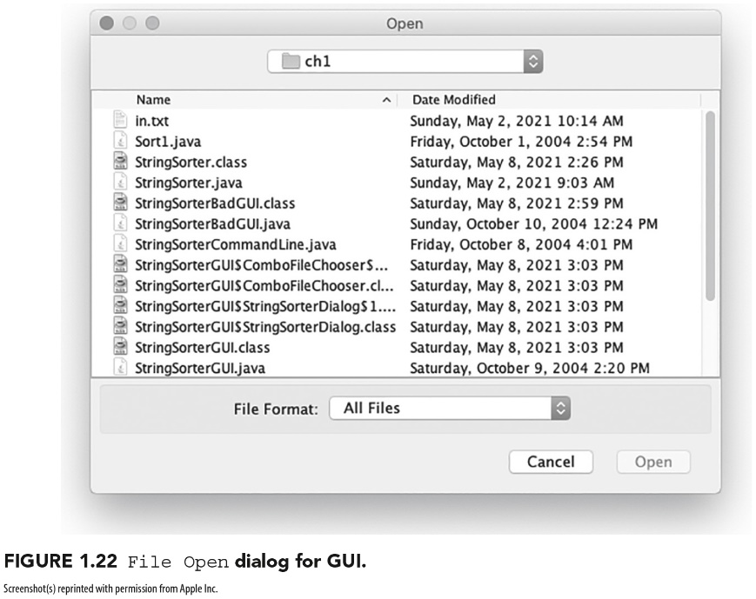
Version 1. Estimate total minutes
Write a program that reads lines from one file and writes the sorted lines to another file.
Assume that you will be writing the sort routine yourself and will implement a simple GUI (first image).
Pressing one of the two buttons displays a File Open dialog (second image), where the user can navigate the computer’s file system and choose a file.
Assume that you can work only on this one task, with no interruptions.
Step 1. Estimated ideal total time: _________________

Slide 27
Version 2. Estimated calendar time
Is the assumption that you will be able to work straight through on this task with no interruptions realistic?
Won’t you need to go to the restroom or drink some water?
Can you spend the time on this task?
If you were asked to do this task as soon as reasonably possible, starting right now, can you estimate when would you be finished?
Given you starting now, estimate when you think you will have this program done to hand over to the client
Also give an estimation of the time you will not be on task (for example: eating, sleeping, other courses, etc.)
Step 2. Estimated calendar time started: _________ Ended:___________ Breaks:_____

Slide 28
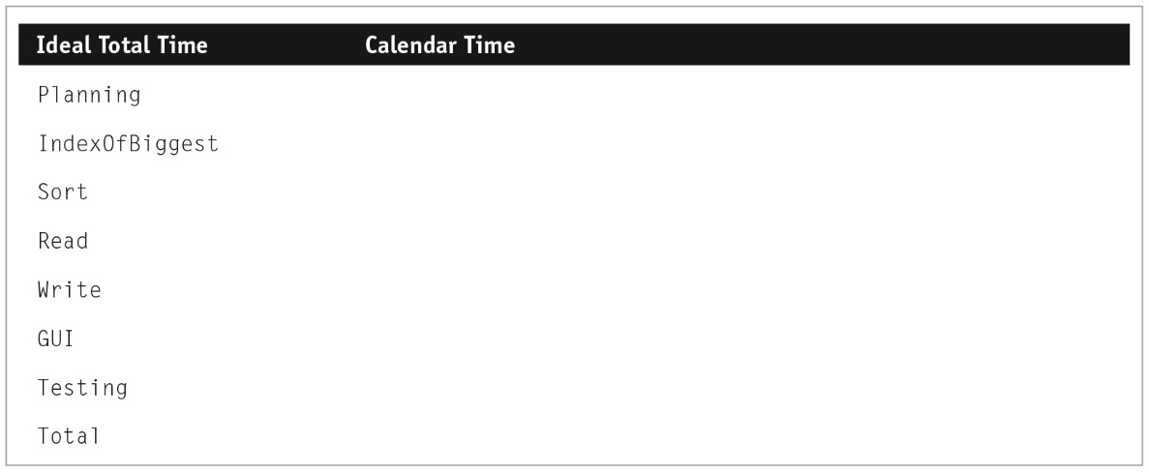
Version 3. Estimation of subtasks
Divide the entire program into separate developmental tasks and those tasks might be divided into several subtasks.
Your current task is a Planning Task, which has estimation as a subtask.
When thinking of the requirements for the project, assume you will create a class, called StringSorter, with three public methods: Read, Write, and Sort.
For the sorting routine, assume that your algorithm involves finding the largest element, putting it at the end of the array, and then sorting the rest of the array using the same mechanism. Assume you will create a method called IndexOfBiggest that returns the index of the biggest element on the array.

Slide 29
A “Simple” Set of Steps (1 of 3)
Understand the problem — requirements
Functionalities
Non-functionalities: performance, security, modifiability, marketability, etc
Perform some design — based on requirements
Organizing the functionalities in some sequence; possibly using some diagrams
Focus on input/output (data, formats, organization)
Think about some constraints (non-functionalities) such as speed, UI looks, programming language, dependencies, etc
Any specific algorithm and improvements on sequence of functionalities

Slide 30
A “Simple” Set of Steps (2 of 3)
3) Code/Implement — turning the design into actual code
Depending on how much design is completed, one may either directly engage in conversion to code (language dependent) or do some more designing
A) Converting input/output to specific UI Interface or I/O format
B) Sequencing the processing in the desired order
C) Ensuring and converting the processing “algorithm” correctly to the target language construct
D) Figuring out how to use language library (properly)

Slide 31
A “Simple” Set of Steps (3 of 3)
4) Verify/Test the program — check the program results (via output) with some predetermined expected set of inputs.
The pre-determined inputs are “test cases” and require some thinking.
If the results do not match what is expected then:
“Debug”
Fix
Retest — reverify
Stop when all test cases produce the expected results.

Slide 32
Answer in Canvas (think for a couple of minutes)
Consider A “Simple” Problem:
Write a “program” in your favorite language that will accept numerical numbers as inputs, compute the average, and output the answer.
Answer these questions in class:
How long (in elapsed time) would it take you to implement this solution?
How much overall effort (in person hours) will this take?
How well will your solution match the problem?
How good is your code/design/documentation/testing?

Slide 33
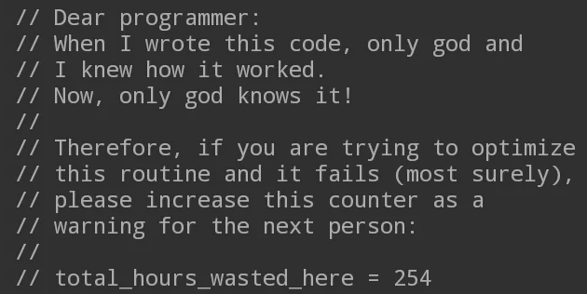
When I wrote this code, only two beings understood it: me and God. Now... it’s just God.
This is why software engineering discipline exist, folks! To understand the importance of clear documentation and clean code

